Slide 1
Introduction to Graphics Programming and its Applications
繪圖程式設計與應用
Quiz 4 FrameBuffer Processing
Examination Time : 17:30~18:20 (50 mins)
Instructor: Hung-Kuo Chu
Department of Computer Science
National Tsing Hua University
CS4505

Slide 2
Objective
Render On your own FrameBuffer.
Do simple image processing.

Slide 3
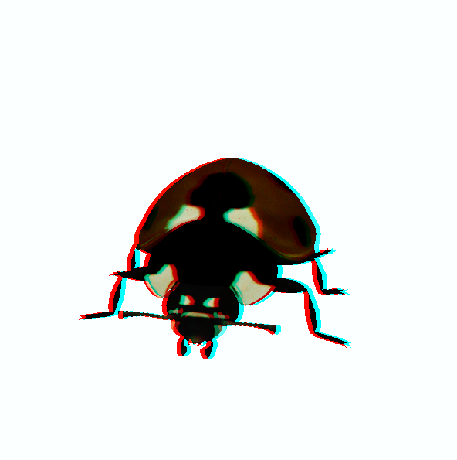
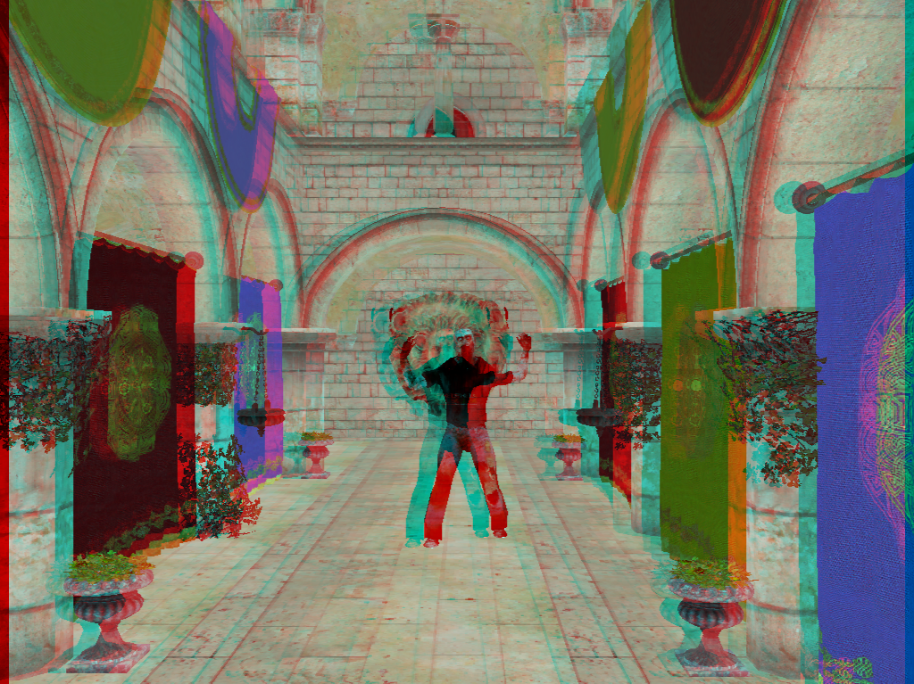
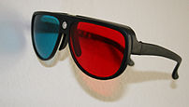
Objective – Red-Blue

Slide 4
Hint
Search “TODO“ and find the section you need to write code
GL_DRAW_FRAMEBUFFER == GL_FRAMEBUFFER, feel free to choose one of them to use ( Don’t confused by the different part from previous course slides and API documentation )
Only need to modify main.cpp
You just need to fill up the blank with some parameters Except the part of shader

Slide 5
Hint
1. Try to render the scene on your own FBO.
A. Create and set up program2. (vao,vbo…..)
B. Create FBO, RBO and FBO_texture and bind them .
C. BindFBO and Draw at Color_Attachment0 .
(in RenderFunction).
D. Switch to default framebuffer.
E. Draw FBO_texture .
2. Apply Red-Blue Stereo algorithm on program2

Slide 6

Red-Blue Stereo (in shader)
(0,1)
(1,1)
texture(tex,texcoord)
(0,0)
(1,0)
Left_Color
Right_Color
(0-offset,1)
(1-offset,1)
(0+offset,1)
(1+offset,1)
(0-offset,0)
(1-offset,1)
(0+offset,0)
(1+offset,1)

Slide 7
Red-Blue Mix Color formula
Default offset = 0.005;
Color_R = Left_Color.r*0.299+ Left_Color.g*0.587+Left_Color.b*0.114;
Color_G = Right_Color.g;
Color_B = Right_Color.b;
color = vec4(Color_R,Color_G,Color_B,1.0);

Slide 8
Rules
You cannot:
Copy & paste others’ code
Ask others to code for you
Discuss with your classmates
You can:
Check any hangouts of this course
Check any websites except community websites
Demo your program window to TAs before you leave the PC room

